Slide 1

Tracking the COVID19 Outbreak
ETL Project Report By: Prajakta Galvankar & Lujane Abdelgadir

Slide 2

Table of contents
Motivations & Summary
ETL Process summary
Extraction
Transformation
Loading
Analysis & Findings
Conclusions & Limitations

Slide 3

Motivations & Summary

Slide 4
Motivations & Summary
Motivation
In late 2019, a novel coronavirus, was identified as the cause of an outbreak of acute respiratory illness in Wuhan, China.
Key Questions to explore
In this report, we will apply the ETL process to analyse the global spread of COVID-19 over the period from January to April 2020
Sources of Information
https://www.worldometers.info/coronavirus/
https://github.com/CSSEGISandData
Center for Systems Sciences and Engineering - Johns Hopkins University
Since the first reports of COVID-19, infection has spread to include more than two million confirmed cases worldwide, prompting the WHO to declare a public health emergency in late January 2020 and characterize it as a pandemic in March 2020.

Slide 5
ETL Process summary

Slide 6
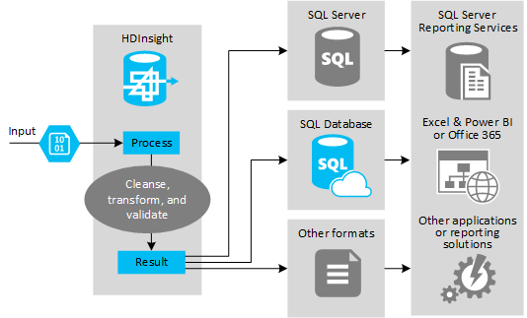
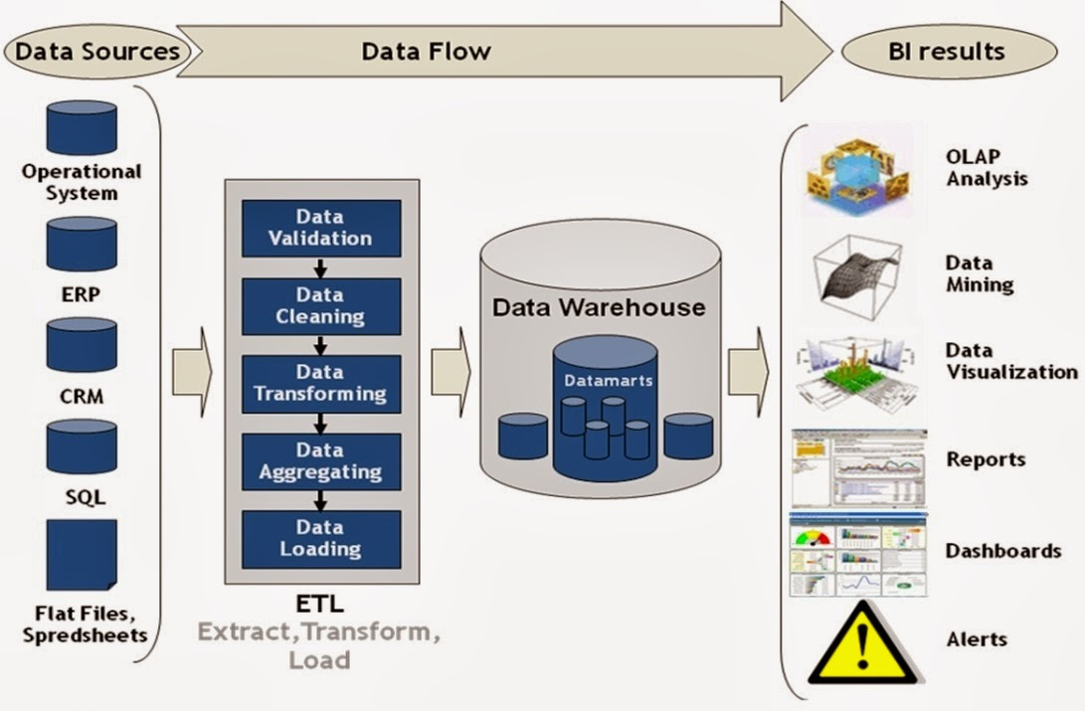

ETL Process summary
The following diagram provides a summary of the ETL process to analyse the data:
Extraction
Transformation
Loading
Analysis
Raw Data
Data Processing
Data Exporting
SQL Server
Loaded and exported the cleaned data onto an SQL engine to analyse.
Cleanse, standardize,
group, sort and validate the data
Structured time-series data covering number of confirmed cases, deaths and recovered cases by country
Other visualization tools

Slide 7
ETL Process summary
Extraction
Transformation
Loading
Extracted CSVs into DataFrames
Removed unnecessary and inconsistent data
Grouped entries by aggregate value
Loaded the cleaned data to SQL and Power BI for analysis
Extracted the data from the three CSV files onto three separate pandas dataframes.
The selected data is structured.
Checked column headers and rows to ensure that all countries and dates are present across the three databases
A few countries were broken down by provinces/states
Removed the provinces/states column because it had limited entries
Grouped the responses by sum per country so that there is one total value per day for each country for consistency
Sorted the data in ascending order for ease of reference
Added an index column for exporting to SQL
Set up a database connection via SQL Alchemy and loaded the files to SQL for analysis. We chose SQL because the data was structured and there are common columns between the files which would allow for analysis using joins.
Also extracted the cleaned data into CSV for analysis on pandas

Slide 8
Analysis and Findings

Slide 9
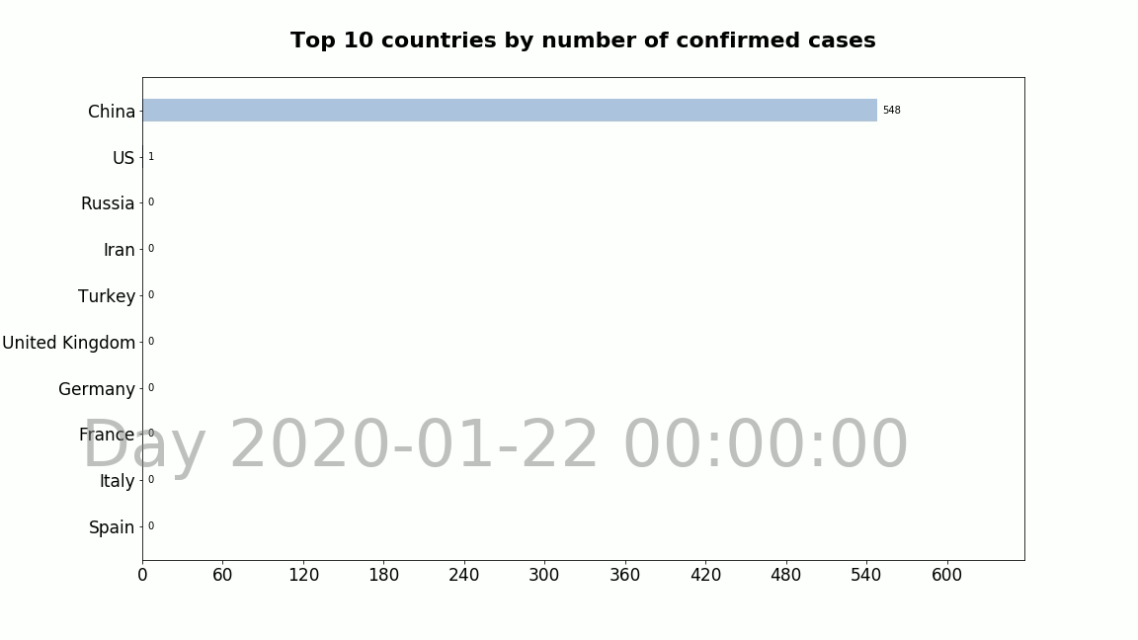
Analysis and findings

Slide 10
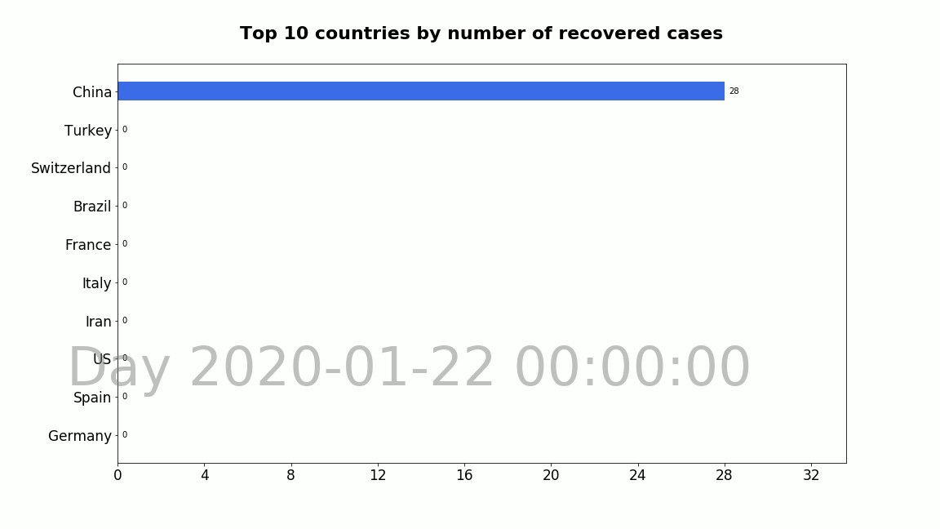

Slide 12
Conclusion and Limitations

Slide 13
Conclusion and Limitations

Slide 14
Thank you!

